Slide 1
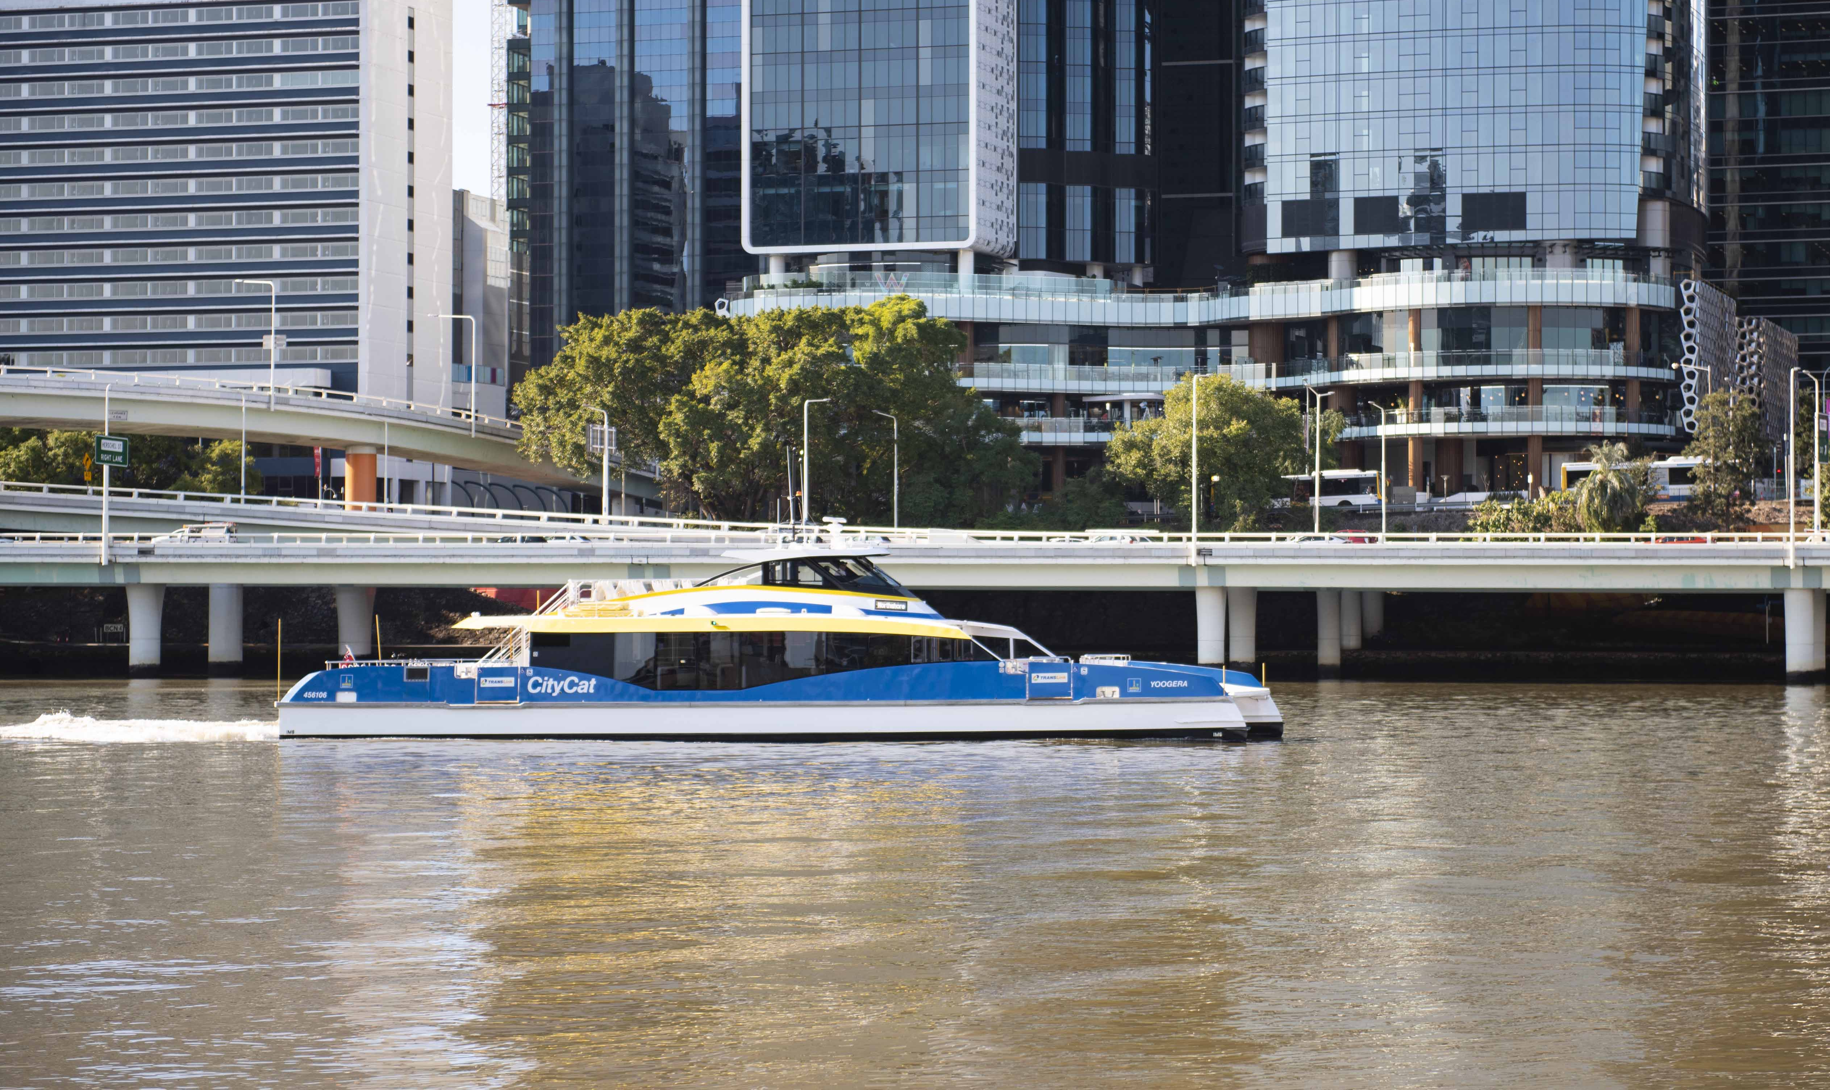
Ferry Network Review
Transport Committee
30 November 2021

Slide 2
Overview
Comprehensive review of existing network
Consultation between May - Oct 2021
Community’s views and experiences of the ferry network including the CityCat, CityHopper and Cross River
Timetable changes being introduced from 13 December 2021

Slide 3
Consultation process
Market research – to develop a greater understanding of Brisbane ferry customers and their needs
Face-to-face community drop-in sessions
100 people attended 16 sessions
Have Your Say online surveys
Three targeted surveys with specific questions focused on objectives of each round
Flyers provided information about the consultation process and drop-in sessions and included QR code for online surveys
Social media, media, advertising, signage and promotions.
Internal communication channels
Living in Brisbane, Council website, Your City Your Say

Slide 4
Consultation overview
The Ferry Network Review has seen high levels of community engagement, ranking among the top response rates in recent Council engagement projects
A total of 21,196 people engaged with Council during four phases of research and community consultation from May to October 2021.
Market research May - June
Round 1 Engagement 12 - 30 Jul
Round 2 Engagement 30 Aug - 17 Sep
Round 2b Engagement 18 Sept - 8 Oct

Slide 5
Research findings
Frequency was consistently identified as an area for improvement throughout the review
24% of respondents placed high priority on faster ferries and quicker journeys (with fewer stops)
32% would use a CityCat if they operated at a high frequency in the evenings
59% participants indicated a strong interest in using express services in the future
Regular commuters found ferries an effective way to avoid traffic congestion during peak periods
55% of ferry users enjoyed travelling on the Brisbane River for leisure and sightseeing
57% of respondents were satisfied with existing ferry services

Slide 6
Review outcomes
Nine extra all stops CityCat services each day during the week (more on Fridays)
New express services and late-night services
CityCats every 15 minutes during the week providing reduced waiting times
Get the CityHopper and Cross River ferry to Howard Smith Wharves and with later operating hours on weekends
Upgraded South Bank terminal opening soon

Slide 7
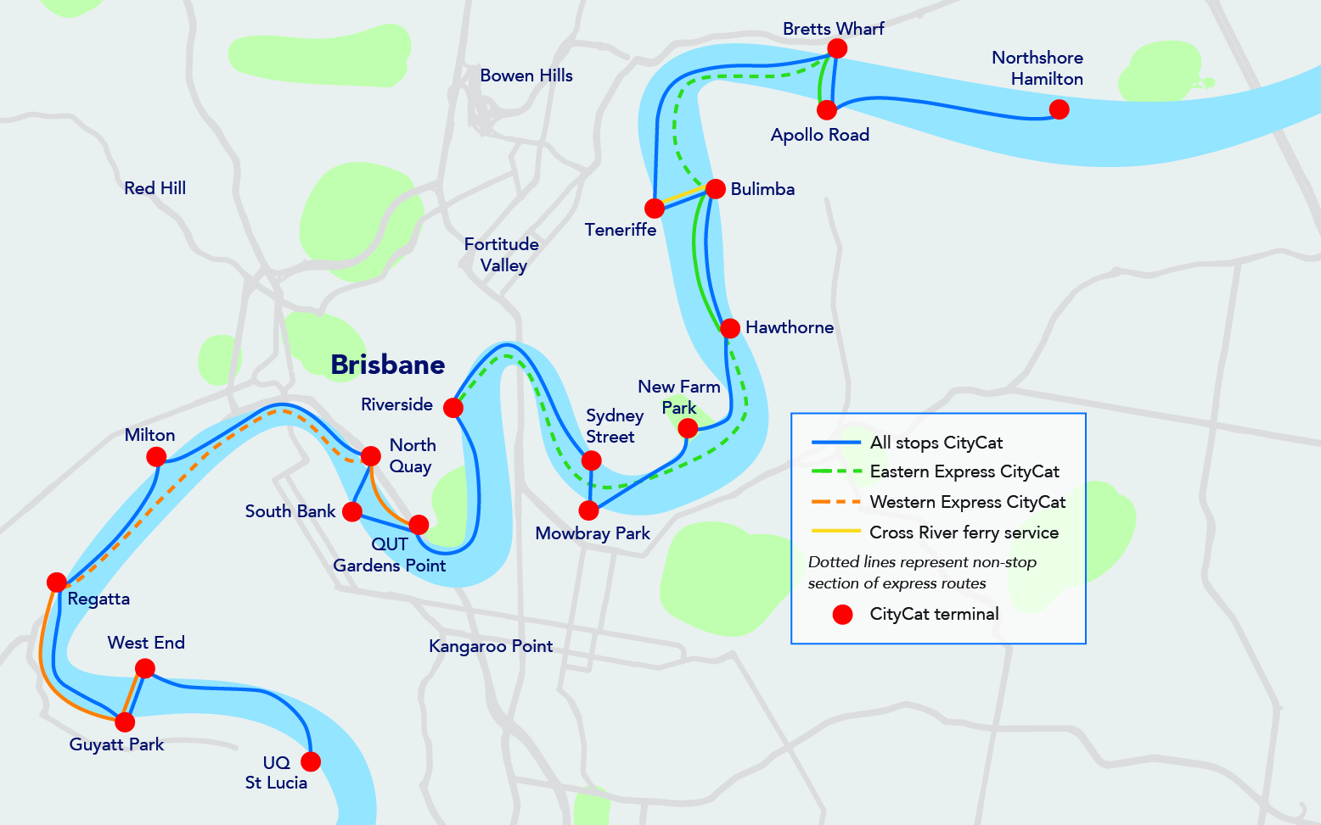
CityCat services
CityCats
Up to 140 all stop services between UQ St Lucia and Northshore Hamilton each weekday
Express CityCats
145 express services each week (excluding weekends & public holidays)
NightCats (12-month trial)
Additional services
15-min frequency on CityCats, Fri to Sat nights until midnight

Slide 8
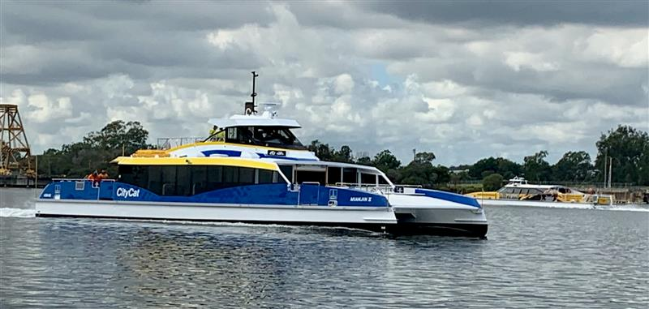
Better CityCat services
59 additional all stop CityCat trips each weekday
Extended 15-minute frequency for weekday all stops CityCat services
Eastern Express CityCat services every 15 minutes between Apollo Road and Riverside in peak times (7-9am and 4-6.30pm weekdays)
Western Express CityCat services every 30 minutes between West End and QUT Gardens Point
More consistent and frequent services for users
NightCat services until midnight on Friday & Saturday nights as part of a 12-month trial

Slide 9
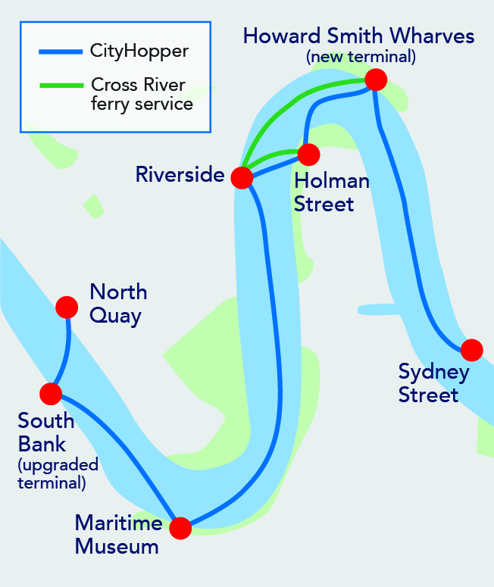
Inner city services
Cross River
Connects Holman Street at Kangaroo Point, Riverside and Howard Smith Wharves, and Bulimba to Teneriffe
Carry up to 60 passengers
CityHopper
Free inner-city ferry service
Seven stops between North Quay and Sydney Street New Farm including Howard Smith Wharves
Every 30 mins between 5.30am and midnight, 7 days (later on Fri and Sat nights)

Slide 10
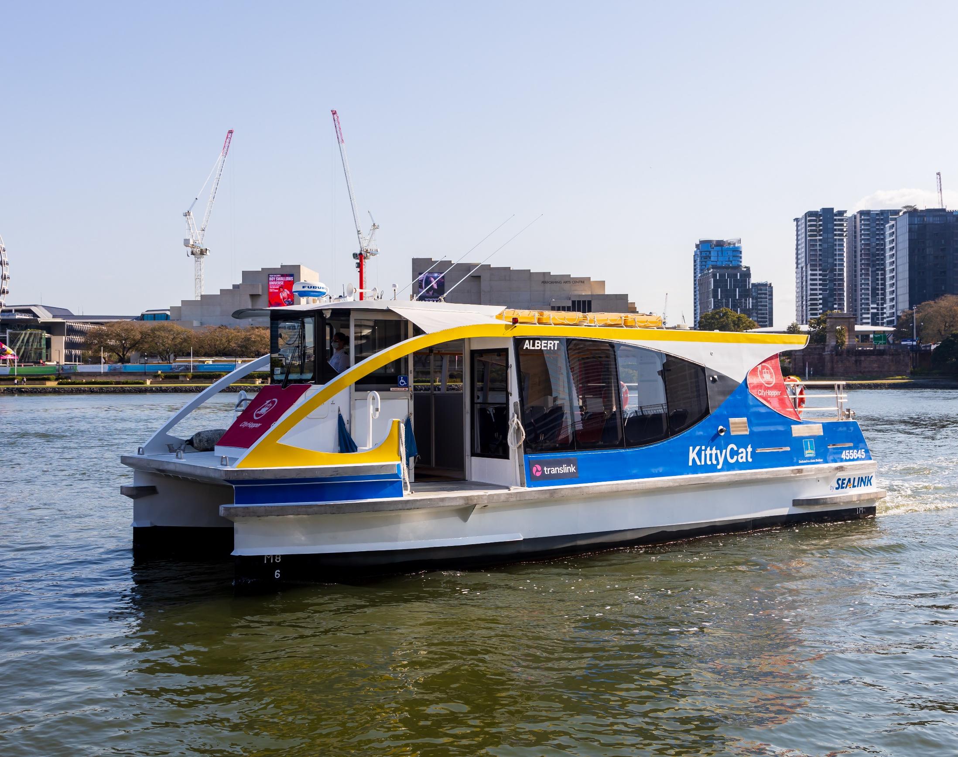
Enhanced inner-city connectivity
Introduction of the CityHopper and Cross River ferry services to the new Howard Smith Wharves terminal – includes later operating hours on Friday and Saturday nights
CityHopper services every 30 minutes
Cross River ferry service every 30 minutes between Holman Street, Riverside and Howard Smith Wharves terminals
Frequent Bulimba-Teneriffe cross-river ferry services integrated with CityCats and CityGlider bus service at Teneriffe and with regular frequency in the peak direction

Slide 11
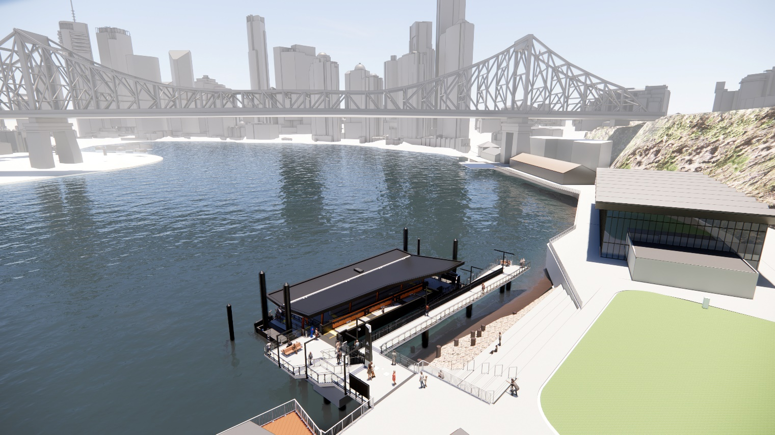
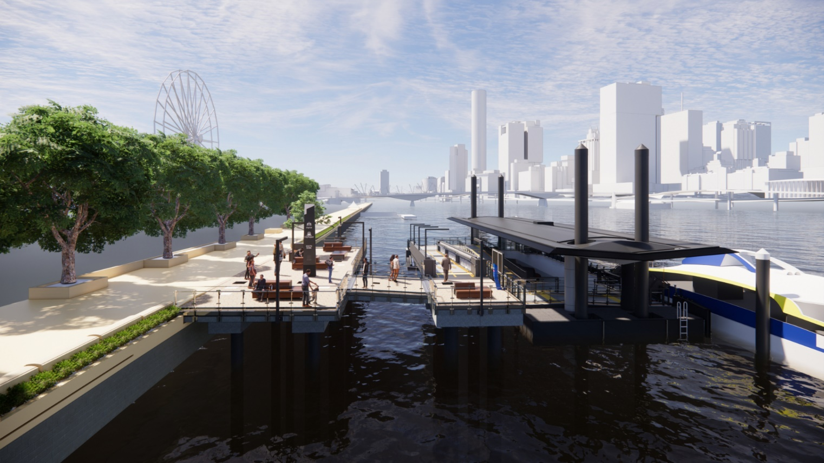
New and improved terminals
Howard Smith Wharves terminal
South Bank terminal
One of Brisbane’s premier recreation and lifestyle precincts
New ferry terminal for Brisbane
Cross River Ferry and CityHopper
Brisbane’s most popular terminal
Important gateway to South Bank Parklands & South Brisbane
Re-opens December 2021
Better accessibility
Extended boulevard platform

Slide 12
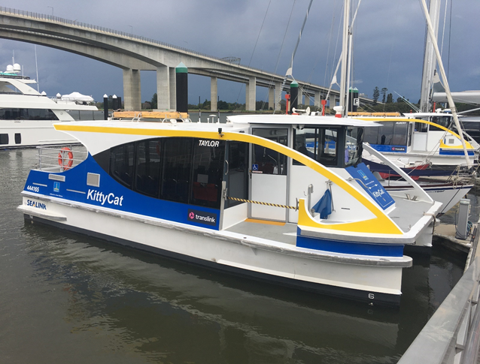
What’s next?
New timetable implementation on 13 December 2021.
Continued preparation work with Translink and RiverCity Ferries.
Continued communication with public about the changes.

Slide 13
Questions?

